Slide 1
Te Whatu Ora Southern RN Preceptor Course
2025

Slide 2
Topics of discussion/korerō
Your Role as an RN preceptor – acknowledgement of extra workload
Expectations of the School of Nursing / Clinical Lecturers / Student concerns
Effective preceptor Feedback
Oral and written feedback
Support as an RN Preceptor
School of Nursing
NZNO guideline principles of Manaakitanga, Whanaungatanga and Kotahitanga
Nursing Council delegation changes - Responsibilities for direction and delegation of care to enrolled nurse
Nurse Educator/Charge nurse
Enrol in online preceptor Moodle course here

Slide 4
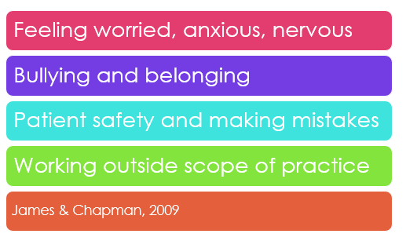
Common student concerns
Will I fit in ?
How will they treat me?
Will I get on with my Preceptor ?
What is the culture like ?
What could we add to this list?

Slide 5
Student Placement structure
BNY1 – 2 x week hospital placement Oct-Nov (across 6 weeks)
BNY2 – 4 x 120hr placements – ARC, community, mental health, acute care
BNY3 – 3 x 120hr placements – acute care, mental health & public health (community project) + 360 hours transition
ENY1 - ARC (120 hours) | Rehabilitation & Community (200hrs)
ENY2 - Acute Care (200hrs) | Mental Health & Addictions (200hrs)

Slide 8
February 2025 – NEW RN standards of competence
PDU working to support this roll-out
OP has updated student documentation to align with the six NEW Pou

Slide 9
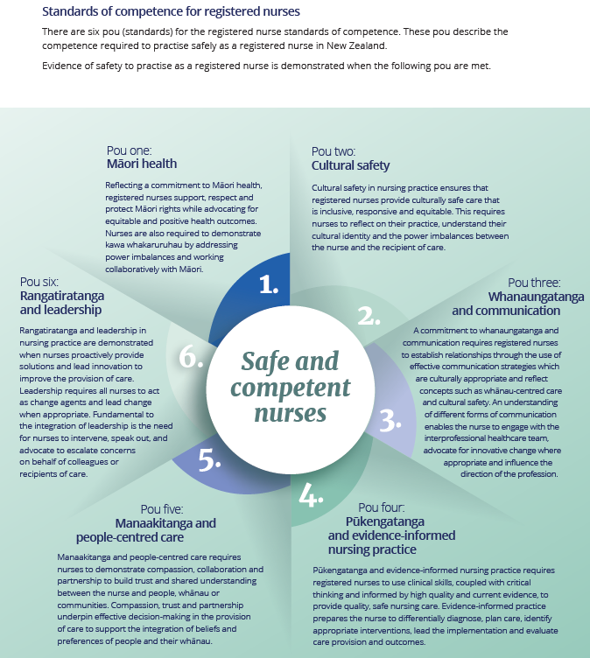

Slide 10
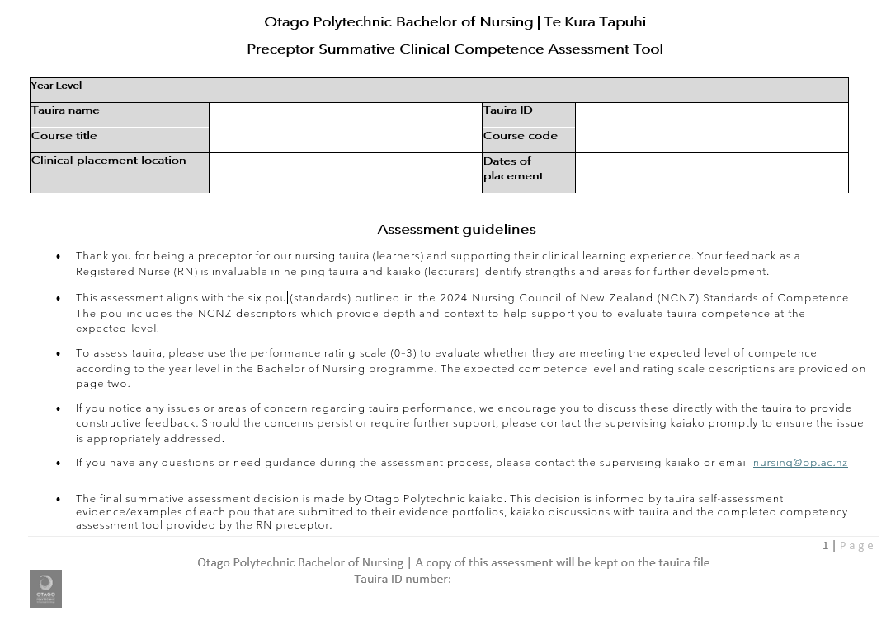
Preceptor feedback

Slide 11
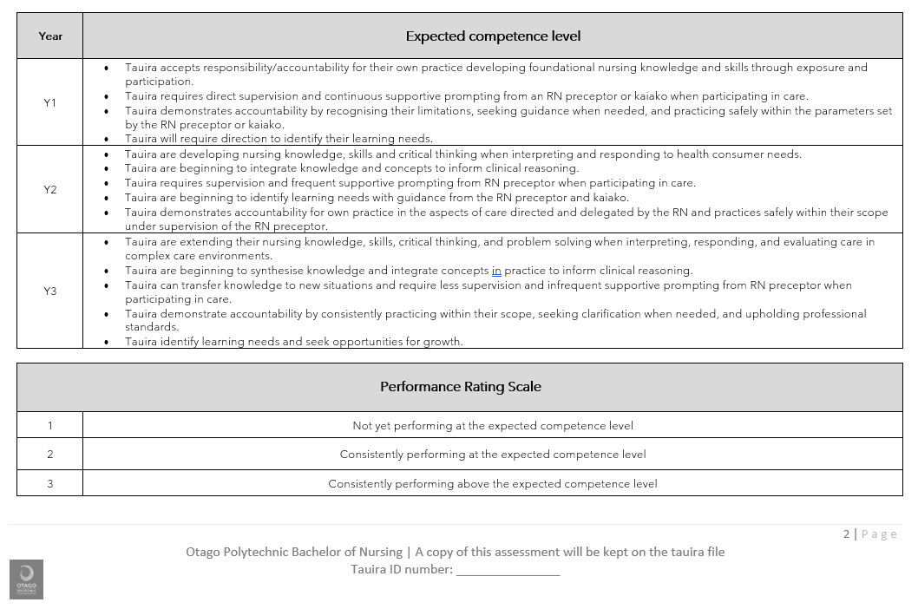

Slide 12
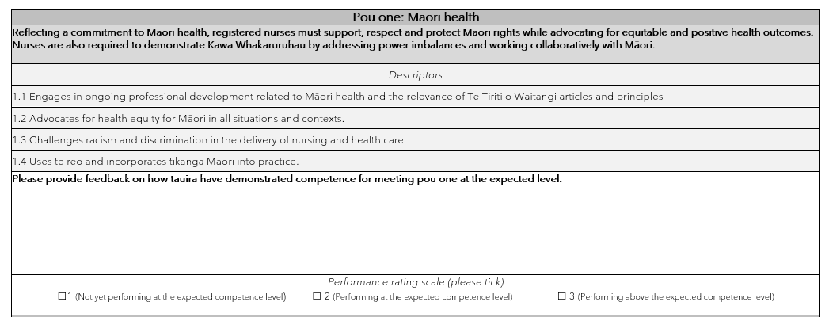
Each pou requires a rating and brief comment

Slide 13
Discussion points

Slide 14
How to support your student/new graduate…
Manaakitānga (hospitality and generosity)
Whanaungatānga (working together to provide a sense of belonging)
Kotahitānga (unity/solidarity)
Briefing/Debriefing 5-10 mins start of shift/end of shift – what went well today?
Help set daily/weekly goals
Any concerns – contact clinical lecturer early
Portfolio work support
Process for ‘Student for Concern’

Slide 15
Support as RN preceptor
Enrol in online preceptor moodle course here
Attend preceptorship workshop
Otago Polytechnic School of Nursing
Clinical Tutor
Clinical Course Coordinator
Programme Leader
Nurse educator
Utilise NCNZ documents
Guideline: responsibilities for direction and delegation of care to enrolled nurse
Code of conduct
Professional responsibilities
Nursing Council competencies

Slide 16
https://online.op.ac.nz/study/nursing/nursing-preceptors

Slide 17
This Photo by Unknown Author is licensed under CC BY

