Slide 1
Te Whatu Ora Southern RN Preceptor Course
2023

Slide 2
Topics of discussion/korerō
Your Role as an RN preceptor – acknowledgement of extra workload
Expectations of School of Nursing/Clinical Tutors/Student concerns
Effective preceptor Feedback
Oral and written feedback
Support as an RN receptor
School of Nursing
NZNO guideline principles of manaakitanga, whanaungatanga and kotahitanga
Nursing Council delegation guidelines: Responsibilities for direction and delegation of care to enrolled nurse
Nurse Educator/Charge nurse

Slide 3
Student Placement structure
BNY1 – 2 week hospital placement September/October (over 6 weeks)
BNY2 – 4 x 120hr placements – aged residential care, primary care, mental health, acute care
BNY3 – 3 x 120hr placements – acute care, mental health & public health (community project) + 360 hours transition
ENY1 - Aged Residential Care (300hrs) | Rehabilitation & Community (200hrs)
ENY2 - Acute Care (200hrs) | Mental Health & Addictions (200hrs)
Competence Assessment Programme – 1 x 240 hr placement

Slide 6
Discussion points

Slide 8
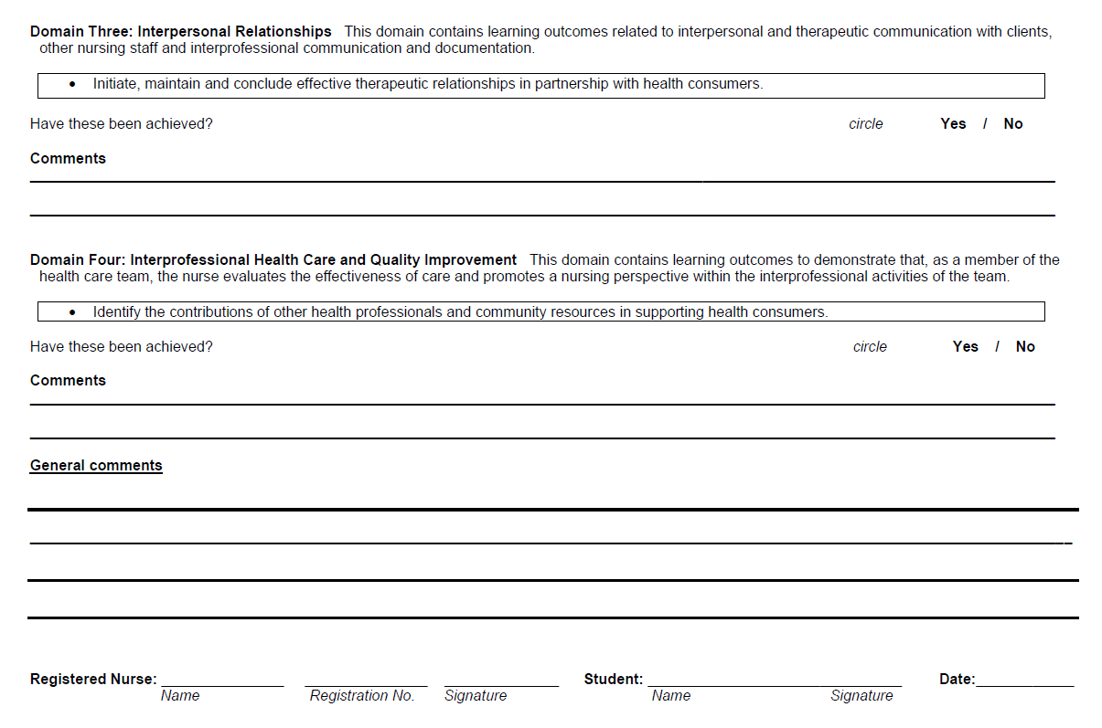
Preceptor feedback
Competencies for registered nurses

Slide 9
How to support your student/new graduate…
Manaakitānga, Whanaungatānga, Kotahitānga
Briefing/Debriefing 5-10 mins start of shift/end of shift
Help set daily/weekly goals
Any concerns – contact clinical tutor early
Portfolio work support
Process for ‘Student for Concern’

Slide 10
Support as RN preceptor
Attend preceptorship workshop
Otago Polytechnic School of Nursing
Clinical Tutor
Clinical Course Coordinator
Programme Leader
Nurse educator
Utilise NCNZ documents
Guideline: responsibilities for direction and delegation of care to enrolled nurse
Code of conduct
Professional responsibilities
Nursing Council competencies

Slide 11
This Photo by Unknown Author is licensed under CC BY

